Slide 1
Terrestrial ecosystem C and N cycling

Slide 2
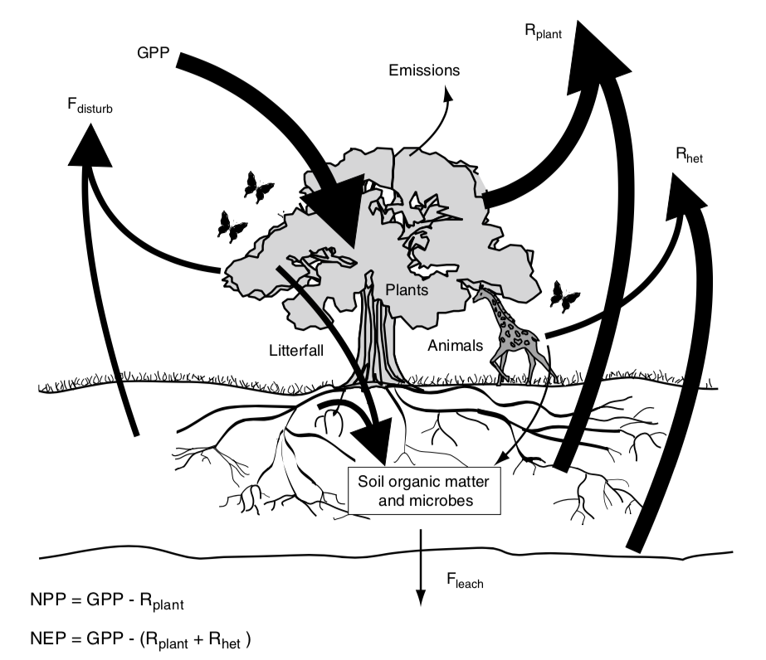
Terrestrial Ecosystem Carbon Cycle

Slide 3
Terrestrial Ecosystem Carbon Cycle

Slide 4
NPP = GPP - R_{plant}

Slide 5
NPP = GPP - R_{plant}
Net Primary Productivity (C into plants – C out of plants; per ground area)

Slide 6
NPP = GPP - R_{plant}
Gross Primary Productivity (total flux of C into plants; per ground area)

Slide 7
NPP = GPP - R_{plant}
Plant Respiration (total flux of C out of plants ; per ground area)

Slide 8
NPP = GPP - R_{plant}
Gross Primary Productivity (total flux of C into plants; per ground area)

Slide 9
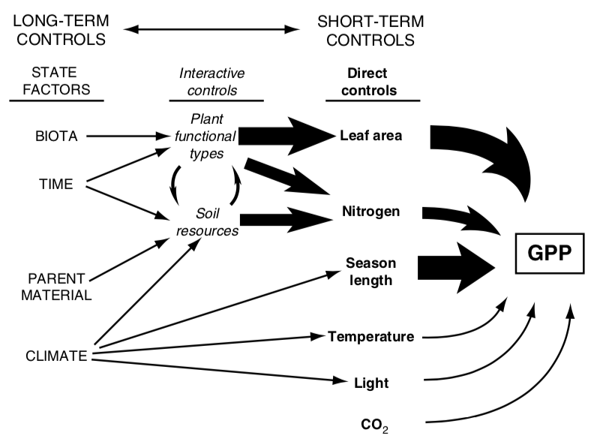

Slide 10
GPP = photosynthesis * LAI

Slide 11
GPP = photosynthesis * LAI
Carbon in to leaves (per leaf area)

Slide 12
GPP = photosynthesis * LAI
Leaf area index (leaf area per ground area)

Slide 13
GPP = photosynthesis * LAI
Carbon in to leaves (per leaf area)

Slide 14
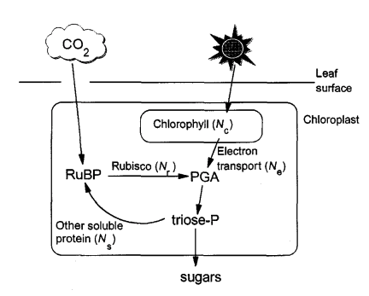
Simple recap of photosynthesis
Medlyn 1996

Slide 15
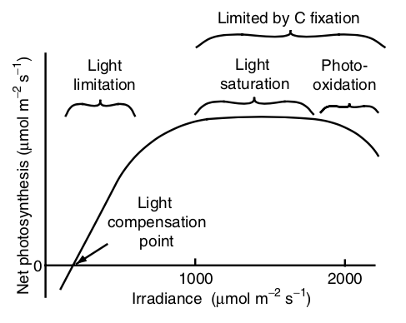
Environmental responses - light

Slide 16
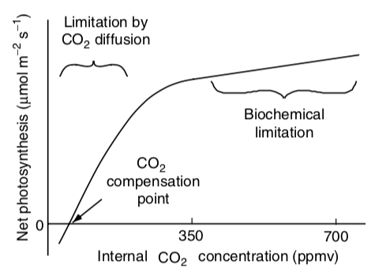
Environmental responses – CO₂

Slide 17
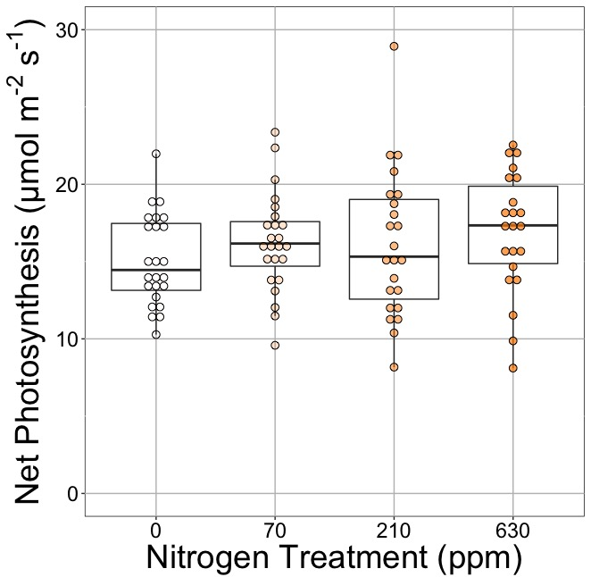
Photosynthesis is less responsive to soil resources (water and nutrients). Why?
Waring et al. (2023)

Slide 18
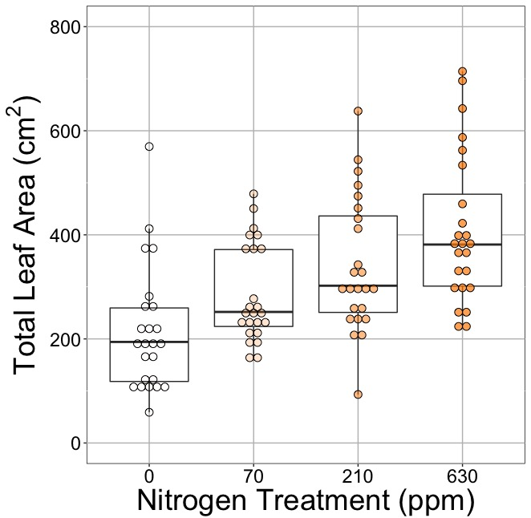
Photosynthesis is less responsive to soil resources (water and nutrients). Why?
Waring et al. (2023)

Slide 19
GPP = photosynthesis * LAI
Leaf area index (leaf area per ground area)

Slide 20
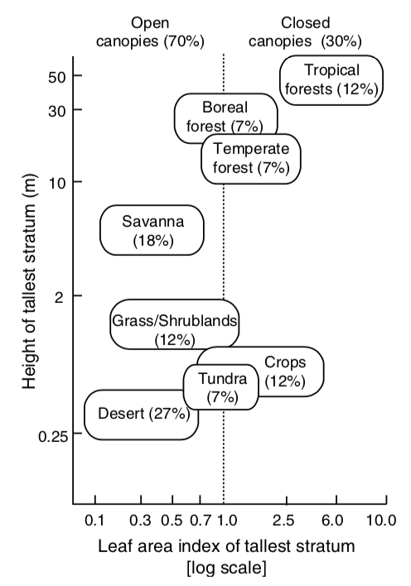
What’s driving the x-axis distribution?

Slide 21
What’s driving the y-axis distribution?

Slide 22
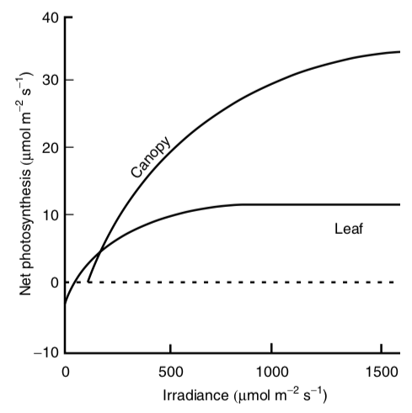
Canopies tend to have higher light use efficiency than leaves

Slide 23
NPP = GPP - R_{plant}
Plant Respiration (total flux of C out of plants ; per ground area)

Slide 24
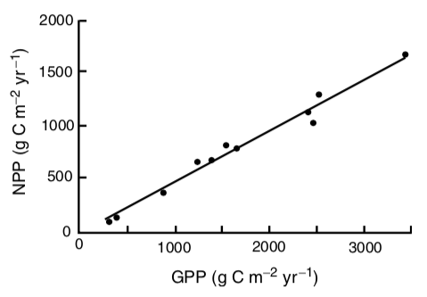
NPP = GPP – 0.47*GPP
Originally proposed by Waring (1998)

Slide 25
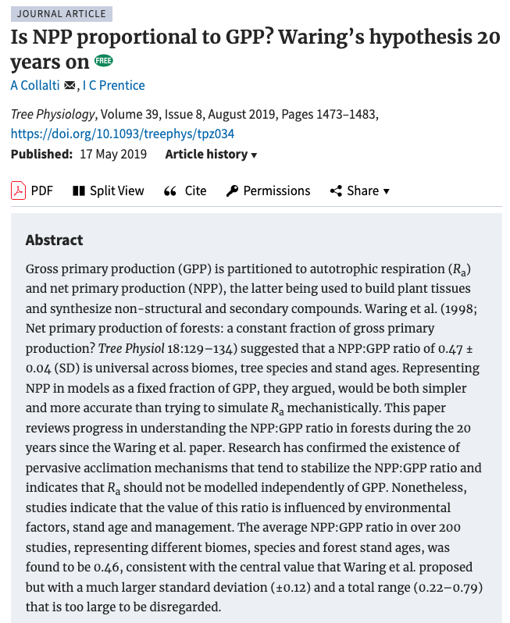

Slide 26
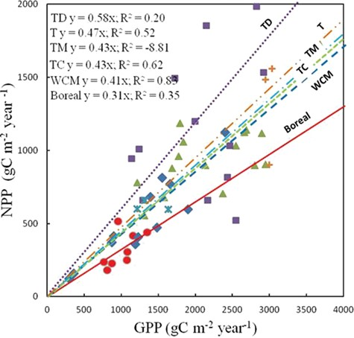
NPP – GPP relationship varies slightly by biome
Collalti and Prentice (2019)

Slide 27
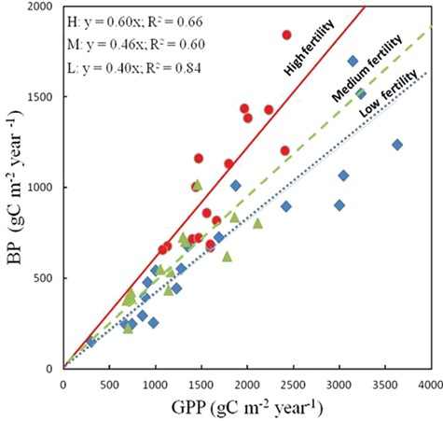
NPP – GPP relationship varies slightly by soil resources
Collalti and Prentice (2019)

Slide 28
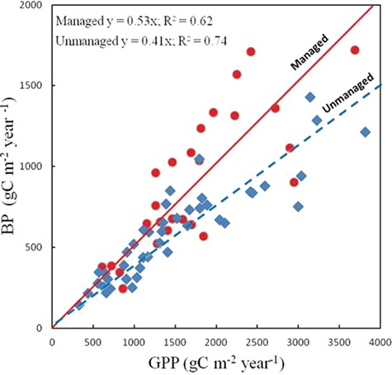
NPP – GPP relationship varies slightly by management
Collalti and Prentice (2019)

Slide 29
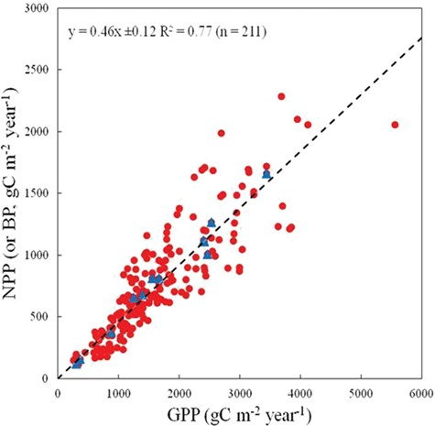
With more data, the relationship on average is still close to Waring’s
Collalti and Prentice (2019)

Slide 30
What drives NPP?
Over short time scales (seconds to days)
Photosynthesis
Light, temperature, atmospheric conditions
Over long time scales (weeks to months)
LAI
Growth demand
Management
Soil resources

Slide 31
Terrestrial Ecosystem Carbon Cycle

Slide 32
NEP = GPP – (R_{plant} + R_{heterotroph})

Slide 33
NEP = GPP – (R_{plant} + R_{heterotroph})
Net ecosystem production (total flux of C into ecosystem; per ground area)

Slide 34
NEP = GPP – (R_{plant} + R_{heterotroph})
Heterotrophic respiration (C flux out from heterotrophs; per ground area)

Slide 35
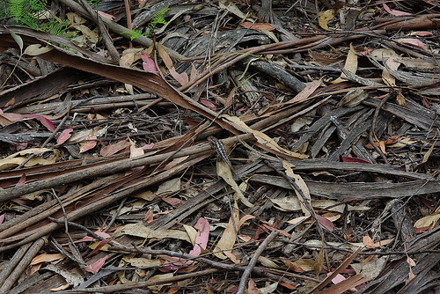
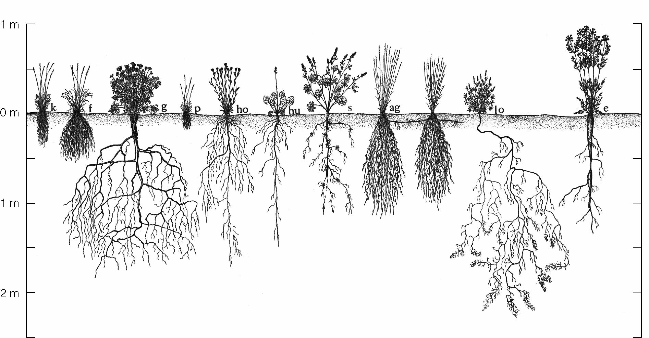
Detritus

Slide 36
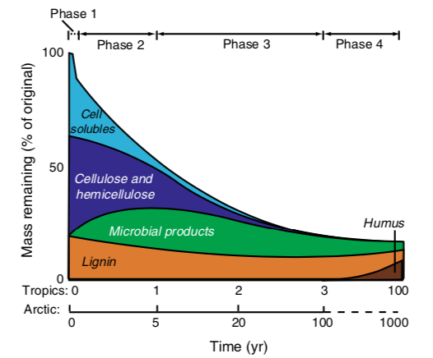
Microbes break down easy stuff before moving to more recalcitrant material

Slide 37
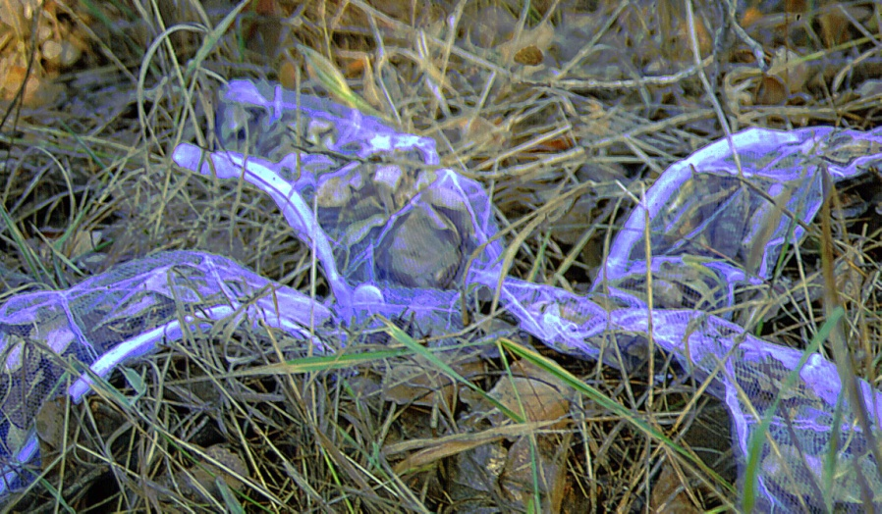
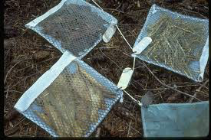
The rate of decomposition

Slide 38
The rate of decomposition
Slope = decomposition rate (K)

Slide 39
Major controls of decomposition
Litter Quality
Climate
Decomposition
Soil Fauna

Slide 40
Major controls of decomposition
Litter Quality
Climate
Decomposition
Soil Fauna

Slide 41
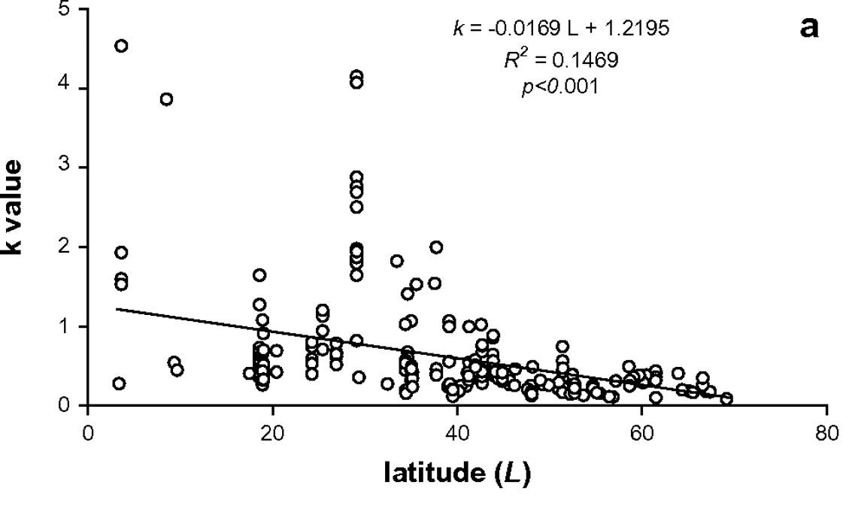
Climate and decomposition
Zhang et al. 2008

Slide 42
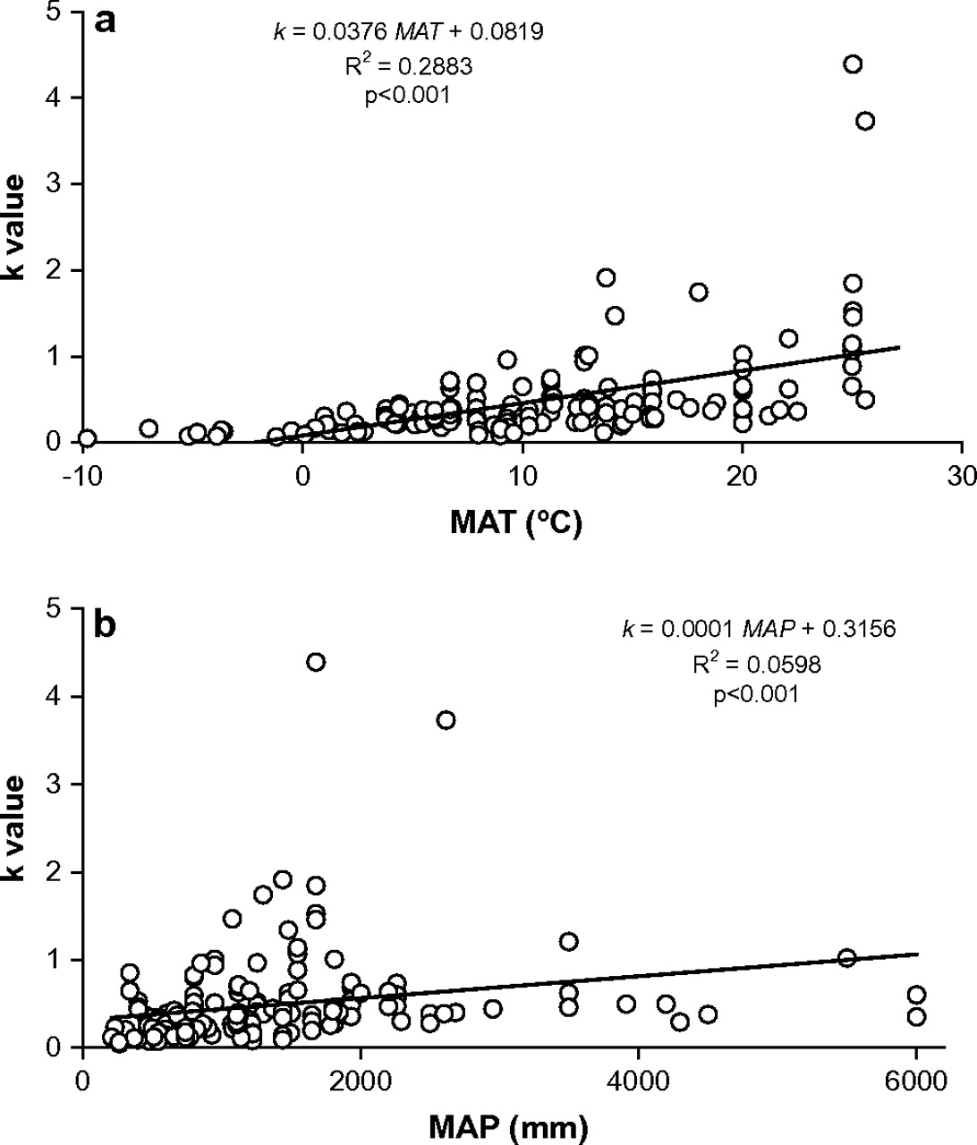
Climate and decomposition
Zhang et al. 2008

Slide 43
Major controls of decomposition
Litter Quality
Climate
Decomposition
Soil Fauna

Slide 44
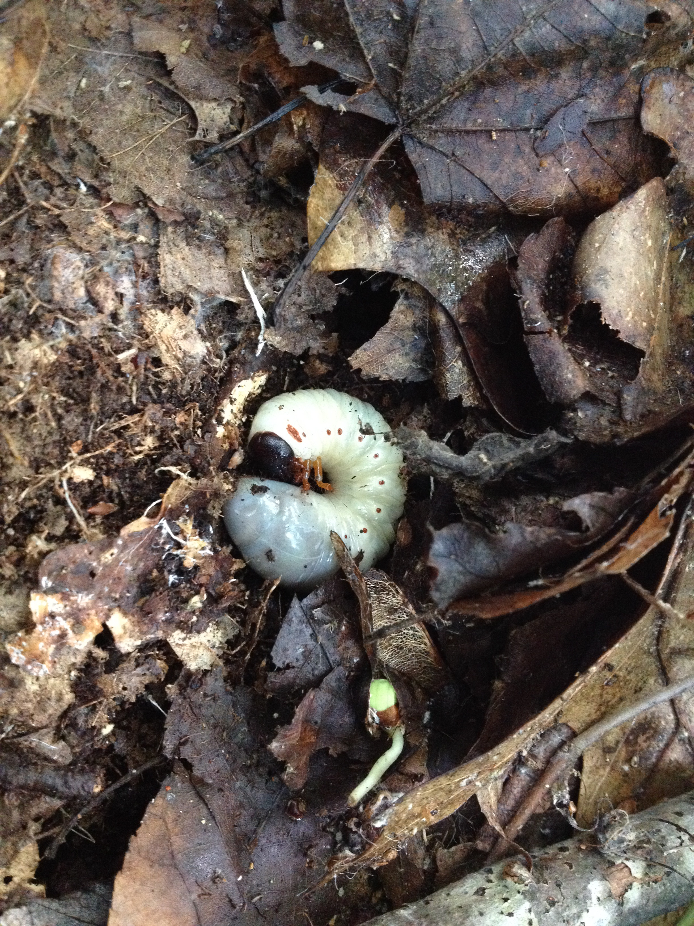
Soil organisms
Breakdown organic material
Releases mineral nutrients
Stabilizes soil structure
Forms humus
Inorganic transformations
Transforms N, P, S into plant available forms
Nitrogen fixation
Fix N₂ from atmosphere

Slide 45
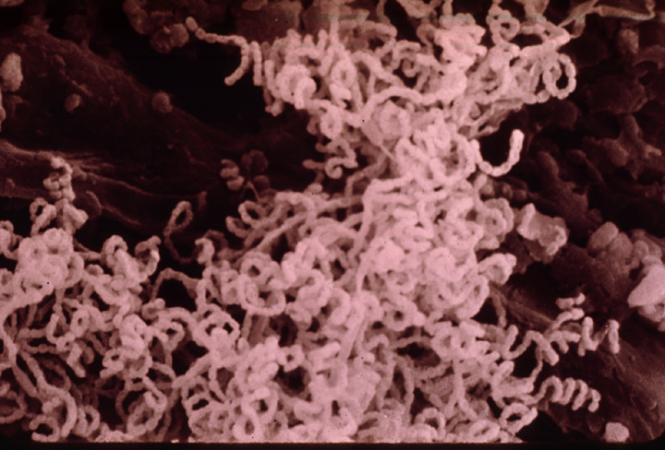
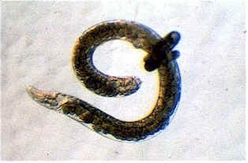
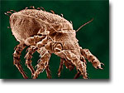
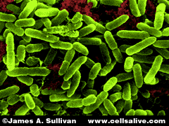
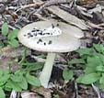
Microbial community characteristics determine litter decomposition
Community composition
Who’s there
Enzyme activity – speed breakdown
Most processes are mediated by enzymes secreted

Slide 46
Major controls of decomposition
Litter Quality
Climate
Decomposition
Soil Fauna

Slide 47
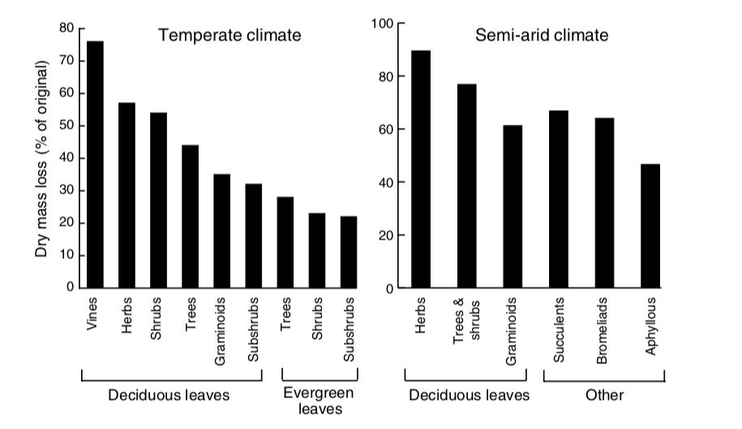
Litter quality varies with plant type

Slide 48
Litter quality varies with plant type
Why don’t all decompose fast?

Slide 49
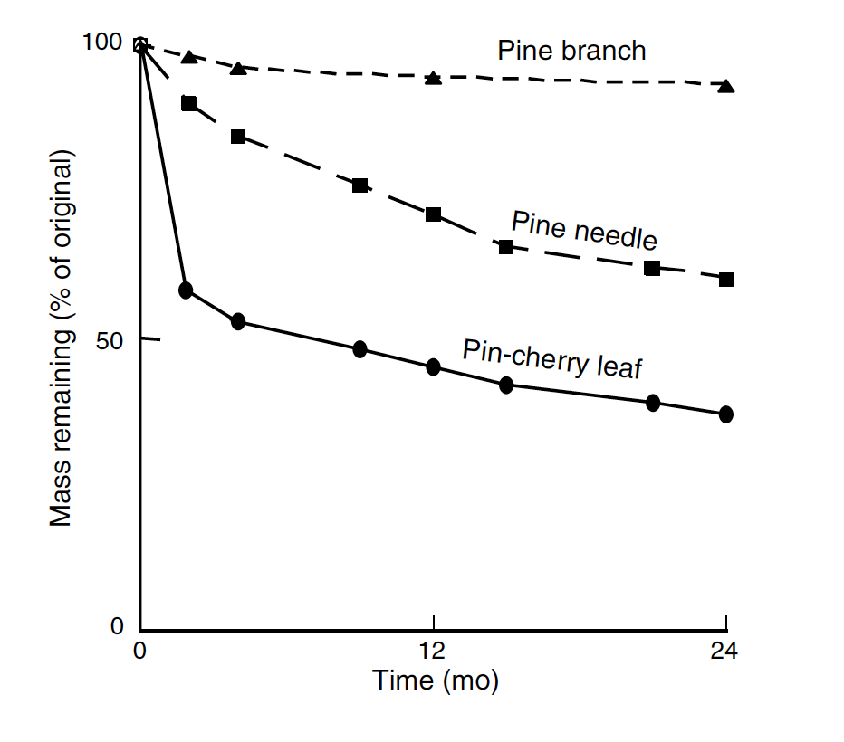
Leaves decompose faster than branches

Slide 50
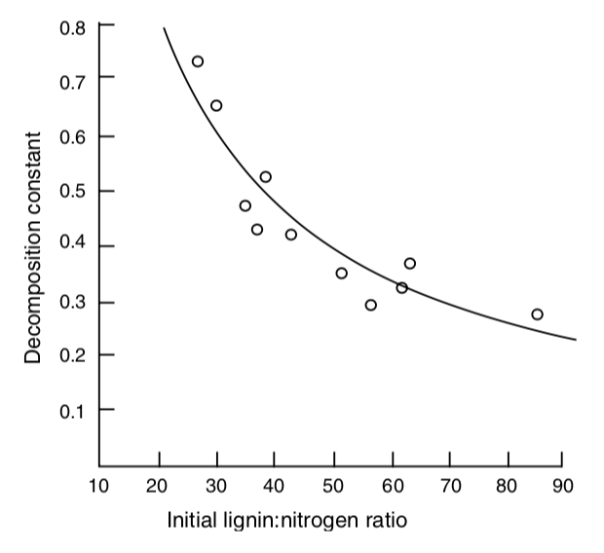
Higher nutrient litter decomposes faster

Slide 51
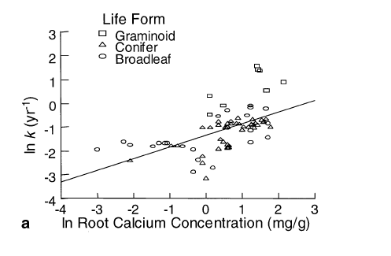
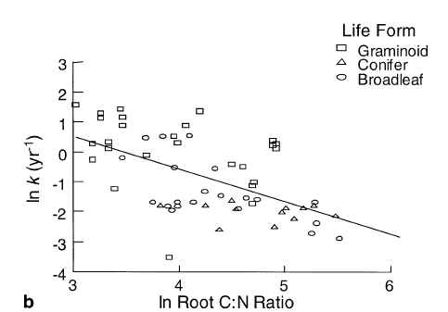
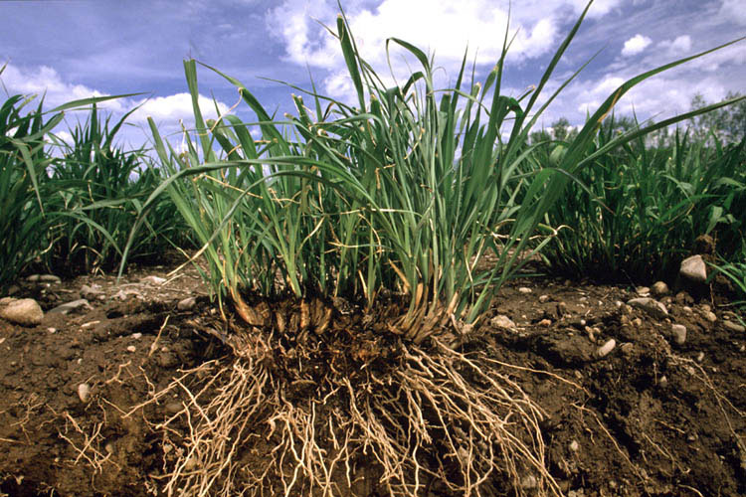
Higher nutrient litter decomposes faster
Silver & Miya 2001

Slide 52
Major controls of decomposition
Litter Quality
Climate
Decomposition
Soil Fauna

Slide 53
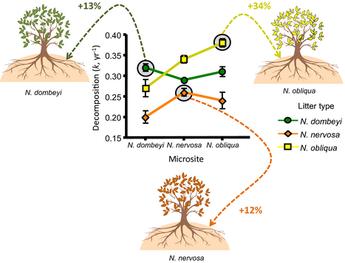
Home Field Advantage
Do microbes decompose substrates that they’ve
“seen” before better than naïve substrates?
Austin et al. 2014
Notes:
Nothofagus

Slide 54
Nutrient cycling

Slide 55
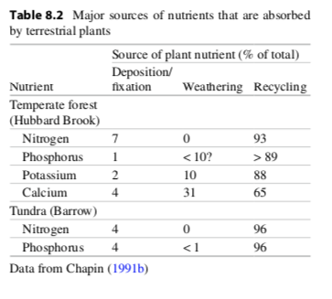
Nutrients cycle through ecosystems differently

Slide 56
Nutrients cycle through ecosystems differently

Slide 57
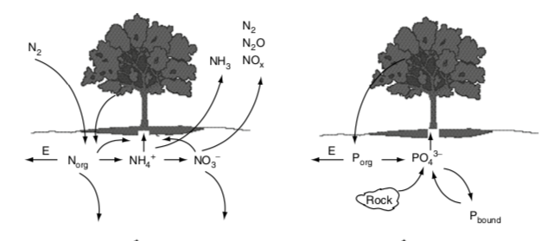

Slide 59
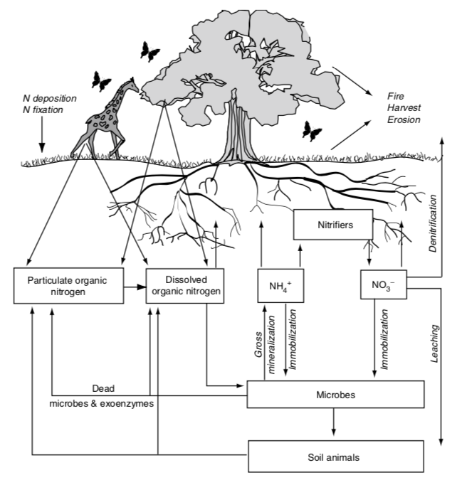
The terrestrial N cycle

Slide 60
The terrestrial N cycle
Nitrogen is constantly changing forms due to biological organisms

Slide 61
The terrestrial N cycle
Bacteria
Fungi
Nitrogen is constantly changing forms due to biological organisms (mostly microbes)
USDA

Slide 62
Important N forms
N₂
Nitrogen gas
Lots in the atmosphere
Cannot be taken up by plants or most microbes (just N fixers)
NO₃⁻
Nitrate
Highly mobile
Can be easily taken up by plants and most microbes
NH₄⁺
Ammonium
Mobile
Can be easily taken up by plants and most microbes
Dissolved organic N (DON)
Organic (contains C)
Produced by dead organisms
Cannot be taken up by plants
Can be broken down by microbes

Slide 65
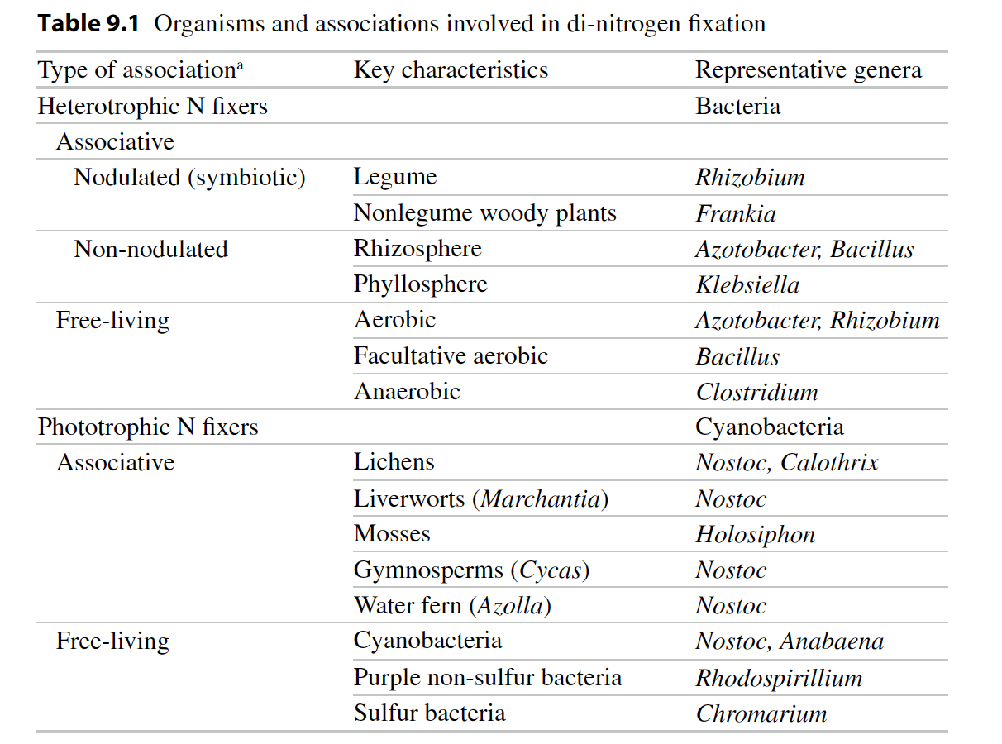
Biological N fixation: N₂ → NH₃

Slide 66
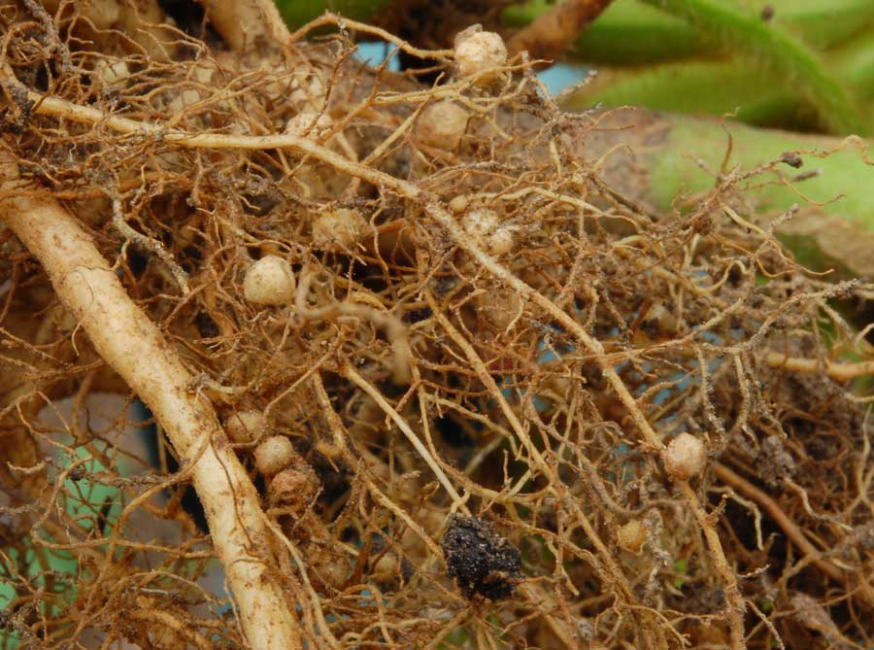
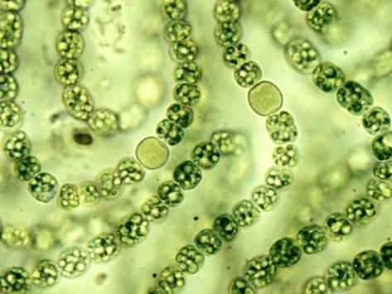
Nodules
Heterocysts
Soil Aggregates

Slide 68
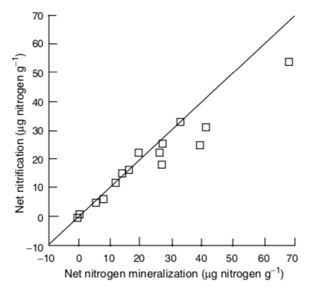
Nitrification: NH₃ → NO₂ → NO₃
Constantly happening in soil and determined by the amount of NH₃ produced by mineralization

Slide 69
Nitrification: NH₃ → NO₂ → NO₃
NH₃ amount explains spatial and temporal variability in nitrification

Slide 70
Nitrification: NH₃ → NO₂ → NO₃
Consequences
N gas production
N more mobile

Slide 72
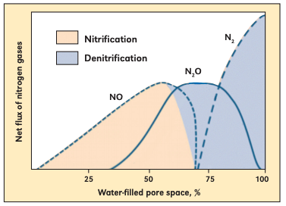
Denitrification: NO₃ → NO, N₂O → N₂
Occurs under high NO₃ and low O₂ conditions (e.g., high soil moisture)
Bouwman (1998)

Slide 74
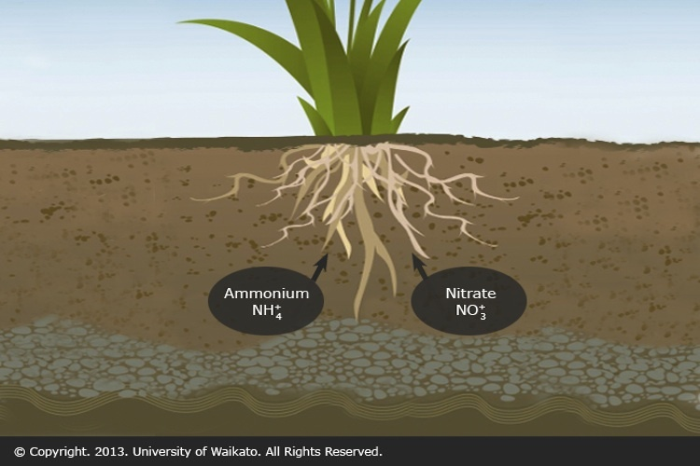
Assimilation: Inorganic N → Organic N
Via microbes or plants

Slide 76
Ammonification + Nitrification = Mineralization

Slide 77
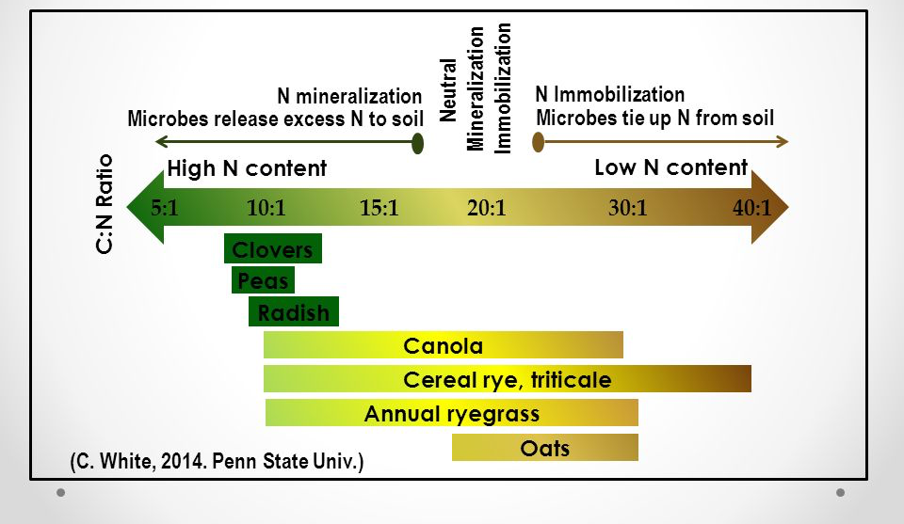
Assimilation: Inorganic N → Organic N Mineralization: Organic N → Inorganic N
Whether you have net mineralization or assimilation depends on the environment
High N = mineralization
Low N = assimilation

Slide 78
Gross Mineralization = Total amount of N released by mineralization (NH₄⁺ and NO₃⁻)
Net mineralization = Gross – immobilization – losses (NH₄⁺ and NO₃⁻)
Net mineralization = available for plant uptake

Slide 79
Linking above- and belowground processes

Slide 80
Linkages between above- and belowground processes
Litterfall-ANPP & Litter quality
Decomposition
Microbial/decomposer activity
DON

Slide 81
Linkages between above- and belowground processes
Rate Limiting Step to N cycling ?
Depolymerization
Litterfall-ANPP & Litter quality
Decomposition
Microbial/decomposer activity
DON

Slide 82
Fate of DON???

Slide 83
Fate of DON
Taken up by mycorrhizae

Slide 84
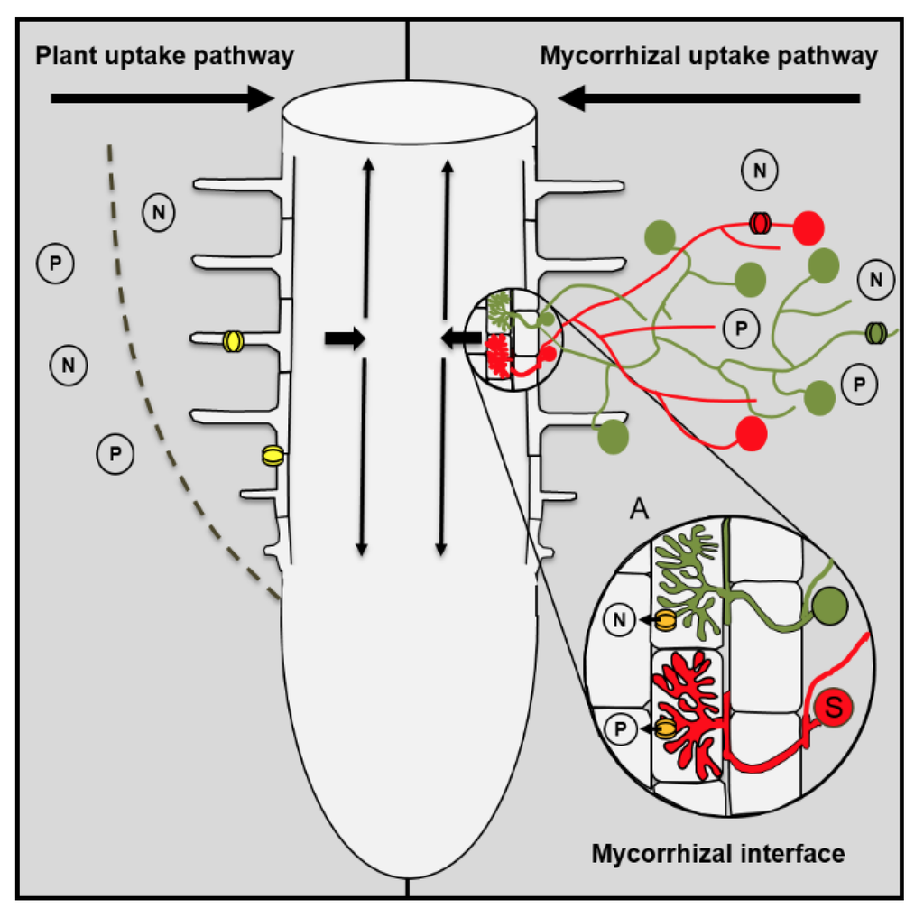
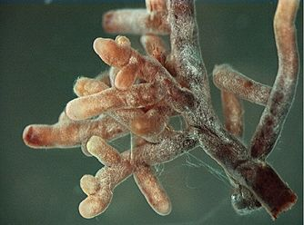
Linkages between above- and belowground processes
DON
Uptake by ECM & plants
Notes:
Taken up by plant (not too common)
Taken up by mycorrhiza
Leached to gw
Absorbed to soils
Taken up by microbes

Slide 85
Fate of DON
Taken up by mycorrhizae
Mineralized by microbes

Slide 86
Nitrogen Mineralization
•N Mineralization results from microbial break-down of DON
•Microbes release NH₄⁺ to soil solution as they use carbon
Organic-N
(R-NH₂) NH₄⁺
Mineralization
(ammonification)

Slide 87
Linkages between above- and belowground processes
CO₂
DON
NH₄⁺
Ammonification
Notes:
Taken up by plant (not too common)
Taken up by mycorrhiza
Leached to gw
Absorbed to soils
Taken up by microbes

Slide 88
Fate of DON
Taken up by mycorrhizae
Mineralized by microbes
Leached (not too common)

Slide 89
Fate of NH₄⁺???

Slide 90
Fate of NH₄⁺
Nitrified by microbes

Slide 91
Linkages between above- and belowground processes
DON
NO₂⁻
NH₄⁺
NO₃⁻
Nitrification
Ammonification
Mineralization
Notes:
Taken up by plant (not too common)
Taken up by mycorrhiza
Leached to gw
Absorbed to soils
Taken up by microbes

Slide 92
Fate of NH₄⁺
Nitrified by microbes
Assimilated up by microbes (not too common)
Assimilated up by plants (not too common)
Leached (not too common)

Slide 93
Fate of NO₃⁻???
Notes:
)

Slide 94
Fate of NO₃
Assimilated by plants

Slide 95
Linkages between above- and belowground processes
Assimilation
DON
NO₂⁻
NH₄⁺
NO₃⁻
Nitrification
Ammonification
Mineralization
Notes:
Taken up by plant
Immobilized
Leached to gw (very mobile)
Absorbed to soils
Reduced by denitrifying microbes to N2, Nox, N20

Slide 96
Fate of NO₃
Assimilated by plants
Denitrified by microbes
Leached

Slide 97
Linkages between above- and belowground processes
Assimilation
N₂
DON
NO_{x}
N₂O
NO₂⁻
NH₄⁺
De-Nitrification
NO₃⁻
Nitrification
Ammonification
Leached to groundwater
Mineralization
Notes:
Taken up by plant
Immobilized
Leached to gw (very mobile)
Absorbed to soils
Reduced by denitrifying microbes to N2, Nox, N20

Slide 98
Speed of N cycling

Slide 99
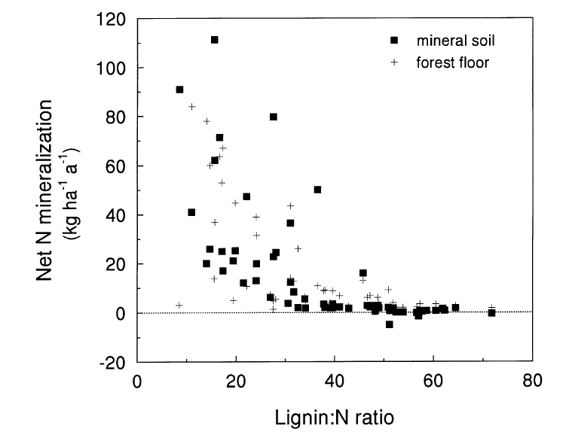
Litter quality increases N cycling
Scott & Binkley 1997

Slide 100
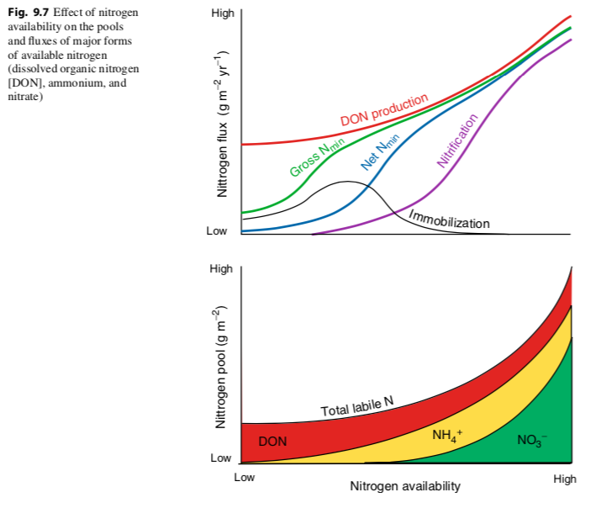

Slide 101
Temperature increases N cycling

